Slide 1
Properties of expected values

Slide 2

Properties of expected values
Let $X_{1},X_{2}$ be two random variables.
$Property 1: E\left(aX_{1}+bX_{2}+c\right)$=$aE\left(X_{1}\right)+bE\left(X_{2}\right)+c$
$Property 2: E\left(X_{1}X_{2}\right)$=$E\left(X_{1}\right)E\left(X_{2}\right)$, if $X_{1}$ and $X_{2}$ are statistically independent

Slide 3
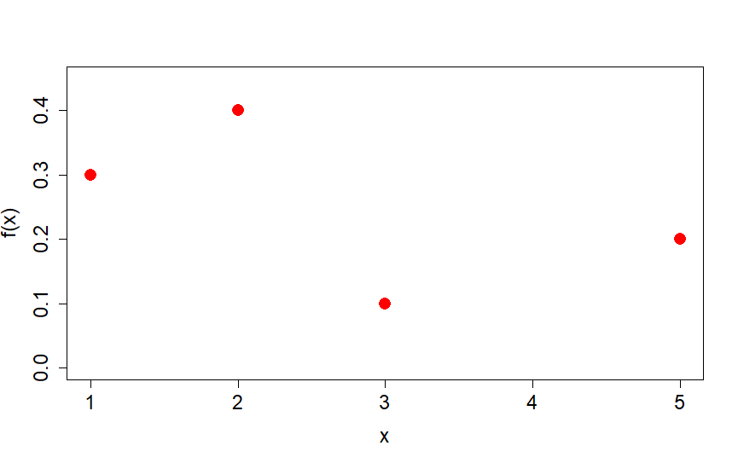
Expectation of independence RV’s
We define the number of customers / hour as a random variable X, whose distribution is shown below.
If we charge each customer $10. E(hourly $) = ?
f(1)=0.3
f(2)=0.4
f(3)=0.1
f(5)=0.2

Slide 4
Properties of expected values
Let $X_{1},X_{2}$ be two random variables.
$Property 1: E\left(aX_{1}+bX_{2}+c\right)$=$aE\left(X_{1}\right)+bE\left(X_{2}\right)+c$
$Property 2: E\left(X_{1}X_{2}\right)$=$E\left(X_{1}\right)E\left(X_{2}\right)$, if $X_{1}$ and $X_{2}$ are statistically independent

Slide 5
Independent events (week 2)
Two events are called independent events, if their conditional probabilities are equal to their unconditional probabilities
$Pr\left(A | B\right)=$ $\operatorname{Pr}\left(A\right)$
Pr({Red object})
Pr({Red object}|{Ball object})

Slide 6
Expectation of independence RV’s
We define the number of customers / hour as a random variable X, whose distribution is shown below.
If we charge each customer $10. E(hourly $) = ?
If each customer has a 50% random chance to be charged either $0 or $10. Knowing the chance is independent of X, E(hourly $) = ?
f(1)=0.3
f(2)=0.4
f(3)=0.1
f(5)=0.2

Slide 7


Example of non-independent RV’s
$$E\left(g(X)\right)=\sum_{\begin{aligned}all prob. values \\ of X\end{aligned}}{g(x)f(x)}$$
What is $E\left(X^{2}\right)?$
f(1)=0.3
f(2)=0.4
f(3)=0.1
f(5)=0.2

